Slide 1
Week 6 Live Session
Wendy Christensen, Ph.D. - COMP 442
Spring 2021

Slide 2
Agenda
Course logistics
Midterm questions
Problem Set 5 questions
Project overview
Review Week 5 Participation
Train-validate-test paradigm
Problem Set 6 review

Slide 3
Upcoming deadlines (all 11:59 p.m. MDT)
Week 5 Participation: Due Sunday, 5/2 (past due, please get these in)
Midterm Exam: Due this Friday, 5/7
Problem Set 5: Due next Friday, 5/14
Week 6 Participation: Due this Sunday, 5/9
Assigned today: Project Plan, due by next Wednesday, 5/12, before live session
Problem Set 6, due next Friday, 5/14

Slide 4
Midterm Questions?

Slide 5
Problem Set 5 Questions?

Slide 6
Project overview

Slide 7
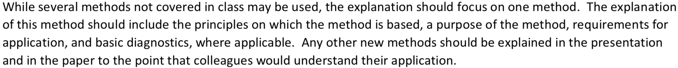
Scope of the project
You may include analyses from class if useful, but they cannot be your primary method.
You can assume that your audience is familiar with descriptive statistics, t-tests, ANOVA, and regression (MLR and logistic); that is, you don’t have to explain these. Your goal is to describe key details about your chosen method so your audience can understand your answer to your research question and how you got that answer.

Slide 8
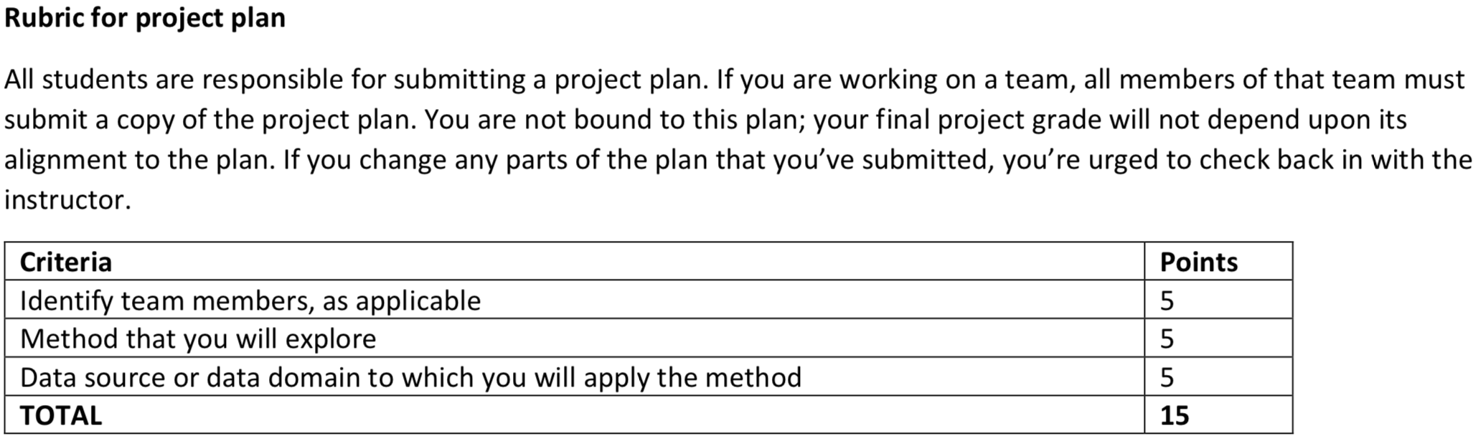
Project plan rubric

Slide 9
Project plan rubric - slight changes
I am making a slight change to this rubric: instead of just one method, you/your group group should submit three ranked choices. Your first choice is the method your group most wants to do, your second is the second-best choice, etc. Your group needs to agree on this ranking. Also, your group needs to agree on who is in your group - be sure to list your group members as part of your project plan.
Popular methods will be randomly assigned to groups that want to do them, although whether this will be necessary depends on what you all choose.
Bayesian methods are acceptable as topics because we will not cover these this quarter. Survival analysis and poisson regression are not because we will cover these.

Slide 10
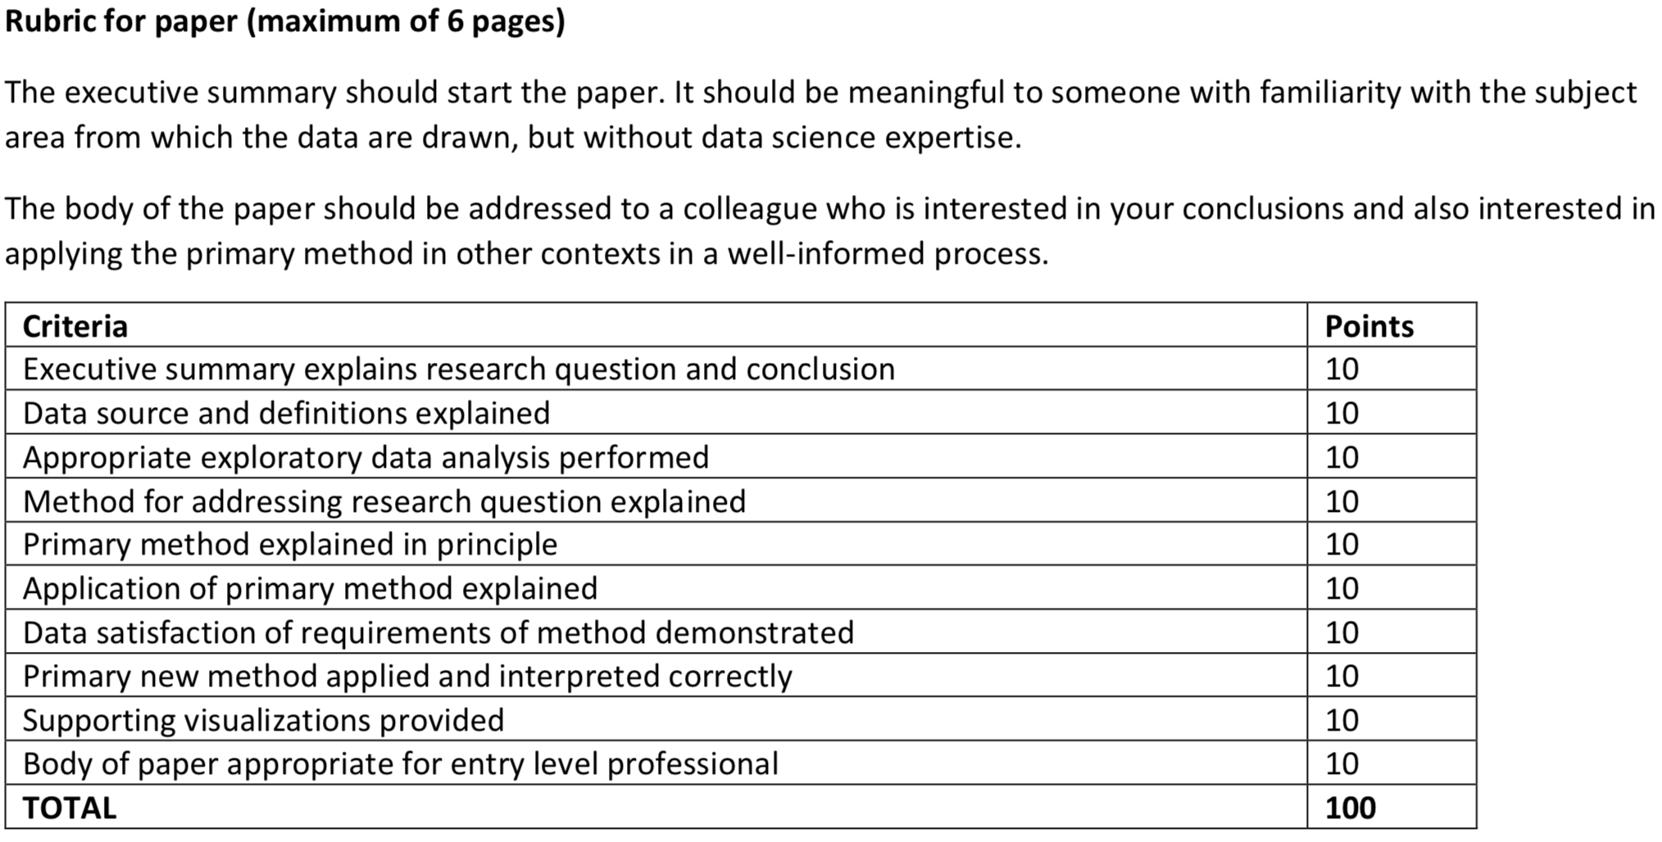
Project paper rubric
This is not a lot of pages - mind your scope!
Notice that the primary method takes up 50% of the total...

Slide 11
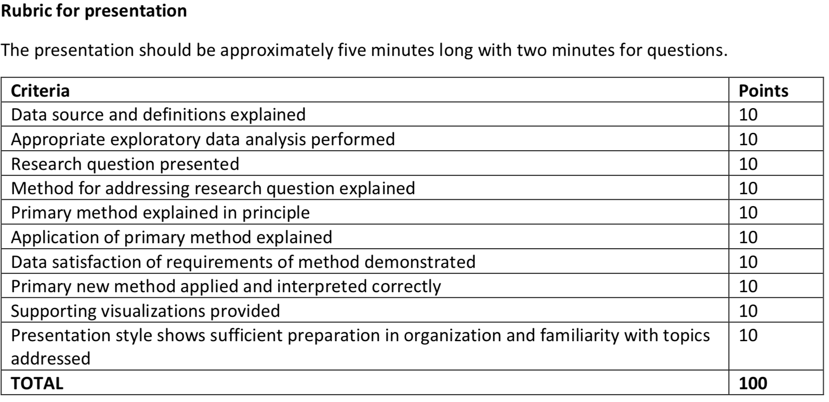
Presentation rubric
This is not a lot of time - practice is key!
Again, notice that the primary method takes up 50% of the total...

Slide 12
Guidelines for working in a group
Working in groups of 2-3 is allowed but not required. The expected presentation length will scale with the number of people (5 min/person, with a 2-minute “grace period” over this limit). The expected amount of detail included in your presentation will also scale accordingly.
For the first time in my classes, you may collaborate on writing the final paper. Unlike the presentation, the expected number of pages will not change based on the group size. Everyone will need to submit a paper to 2U. For those working in groups, I will randomly select the copy of one of the group members to read, so be sure that everyone in your group submits on-time and submits the same paper.

Slide 13
Project deadlines - overview
Project plan: Next week (5/12) by the beginning of the live session (5 p.m. MDT).
Submit these individually under the appropriate assignment submission heading.
During next week’s live session, I will do a poll of your Week 10 availability, which I will use to assign you/your group to a presentation session
Presentations: Week 10 (your specific day TBD next week)
Project paper: The Sunday after Week 10 (6/6) by 11:59 p.m. MDT
Final exam: The Wednesday after Week 10 (6/9) by 11:59 p.m. MDT

Slide 14
Train-validate-test

Slide 15
Generalizability
When trying to decide what model to select, an important consideration is the extent to which a model generalizes to other samples. That is, if I took a model that I estimated based on one sample, would it do a good job in predicting the outcomes of a different sample collected from the same population?
All model selection methods run the risk of overfitting, which occurs when a model that was estimated on one sample produces poor predictions when a different sample is used.

Slide 16

A non-statistical example of generalizability
This untailored suit will fit many people somewhat, but won’t fit perfectly on anyone. The manufacturer chose those measurements to maximize the number of people who will purchase the suit.
Thus, generalizability of measurements is the priority of off-the-rack clothing.
This tailored suit will fit one person perfectly, but it will fit poorly on others. A manufacturer who sold off-the-rack suits with these measurements wouldn't sell very many.
The priority of tailors and bespoke clothing retailers is to overfit garments to particular people.
Retrieved from http://www.businessinsider.com/why-you-should-tailor-clothes-2014-6. Photo by Jaden Lam

Slide 17
Train-validate-test paradigm
One way to increase the likelihood that your chosen model will generalize is to incorporate the ability of models to generalize into your selection procedure.
If you have an ample amount of data, one possibility is the train-validate-test procedure (or, in some cases, just train-test).
Train-validate-test can be used instead of other model selection techniques (e.g., manual comparison of candidate models, automated model selection methods) or in conjunction with them.

Slide 18
Train-validate-test steps
Step 1: Randomly assign observations to be part of your training set, your validation set, or your test set. Each observation can only be in one group.
Proportions of this split vary, but the greatest proportion is used as your training set. The most common splits I’ve seen are 50%-25%-25%, 60%-20%-20%, 70%-15%-15%, and 80%-10%-10%.
Note: In the case of train-test, for which the validation step is omitted, I’ve seen proportions like 60%-40%, 70%-30%, 75%-25%, 80%-20% and 90%-10%.

Slide 19
Train-validate-test steps
Step 2: Generate candidate models and estimate those models using the data in the training set.
Step 3: Using the estimates from the models fitted in Step 2, plug your data from the validation set into each model to generate new predictions. The predict() function is handy for this. The first input is your model object (e.g., doughnuts.aov). The second input indicates the new data from which to generate new predicted values. Note that the proper keyword for indicating your validation set is is newdata=, not data=. Previous experience in this class has shown that data= sometimes causes the predicted values to be incorrect.

Slide 20
Train-validate-test steps
Step 4: Once you have new predicted values, compare these models using a predetermined index of model fit appropriate for your outcome (e.g., mean squared prediction error for continuous outcomes, accuracy for categorical outcomes). Choose the model that is the best per your criterion.
Step 5: Take the estimates from the model you chose in Step 4 and plug the data from your test set into it to get new predictions. Recompute your model fit criterion. It will almost certainly be less than your validation set, but if the chosen model generalizes well, the decrease won’t be severe.

Slide 21
Train-validate-test steps
If you’re doing train-test instead of train-validate-test, there are fewer steps:
Step 1: Randomly assign observations to training and test sets
Step 2: Generate candidate models and estimate those models using the data in the training set.
Step 3: Pick whichever model is the best per your predetermined criterion.
Step 4: Generate new predictions by plugging in data from your test set into the model chosen in Step 3.

